Slide 1


Realized By: Jebali Wafa
MUSIC GENERATION USING LSTM & GAN
FINISHING THE UNFINISHED

Slide 2

تكريمًا لروح الفنان العظيم شوبيرت، يهدف هذا المشروع إلى إحياء السيمفونية غير المكتملة التي تركها وراءه،
واستكمال ألحانه العذبة التي توقفت عند حدود الزمن، لنروي بصدى النغم حكاية فنان لم تكتمل كلماته
2

Slide 3
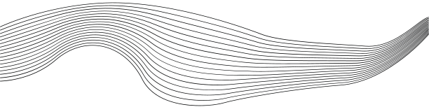
CONTENT
01
PROJECT OVERVIEW
02
REAL SEED DATA
03
LSTM MODEL
04
GAN MODEL
05
GAN VS LSTM
06
CONCLUSION
4

Slide 4




PROJECT OVERVIEW
Project Goal
The goal of this project is to complete Schubert’s "Unfinished Symphony," a masterpiece left incomplete after the composer wrote only two movements, possibly due to illness or shifting focus to other works. By using an LSTM model and a GAN framework trained on his other symphonies, we aim to generate the missing movements based on the seed provided by the unfinished work. The LSTM model captures sequential dependencies in musical structures, while the GAN leverages adversarial learning to enhance the creativity and realism of the generated music. Leveraging these machine learning approaches, we strive to recreate music that stylistically aligns with Schubert's compositions and honors his legacy.
DataSet
Training Data:
29 MIDI files of Schubert’s symphonies from the Classical Music MIDI Dataset.
Seed File:
Schubert’s "Unfinished Symphony" (Symphony No. 8), which will act as the prompt for generating the missing movements.
5

Slide 5
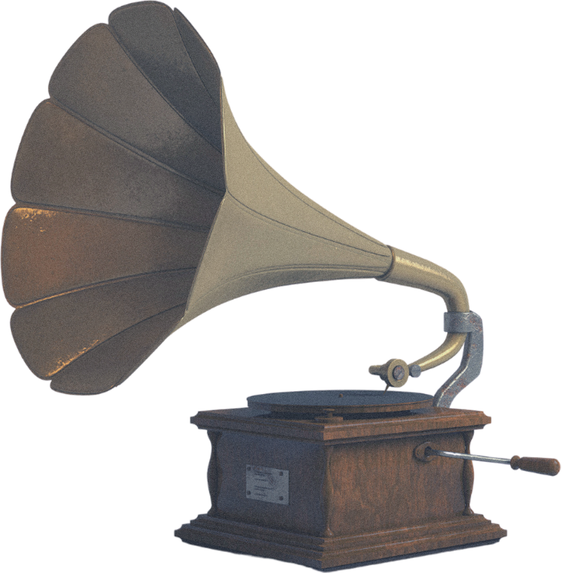


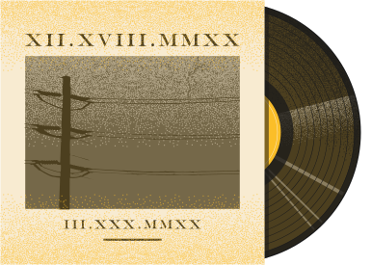
REAL SEED DATA: The Unfinished Symphony No8
Listen to the end of the seed symphony and the beginning of the generated symphonies to see how the models tried to smoothly connect and continue the music.
Click here
The musics are in ‘mid’ format which is not the original format it is a data format we use to manipulate songs.
So in order to listen to the original symphony we recommend this link :
https://www.youtube.com/watch?v=pIytox5x960&ab_channel=Pianifico
6

Slide 6
LSTM MODEL RESULT
8

Slide 7
GAN MODEL RESULT
Generation Result after 80 epochs
10

Slide 8
LSTM VS GAN
Aspect | GAN Model | LSTM Model
Purpose | Generate music sequences based on a random noise vector, aiming for realistic outputs through adversarial training. | Generate music by predicting the next note, offset, and duration based on prior sequences using sequential modeling.
Data Representation | Piano roll format (binary matrix of notes over time), preprocessed for consistency (SEQ_LENGTH) and scaled to [0, 1]. | Notes, offsets, and durations as separate lists, creating a structured representation of musical components.
Preprocessing | - Converts MIDI to piano rolls. - Temporal slicing to ensure fixed-length sequences. - Normalization to improve stability. | - Extracts notes, offsets, and durations. - Creates unique vocabularies. - Encodes data using one-hot vectors.
Architecture | Generator: Fully connected layers with increasing dimensions, batch normalization, and sigmoid activation. Discriminator: CNN with dropout and dense output. | Stacked LSTM layers with dense output layers for predicting notes, offsets, and durations. Tailored to handle sequential dependencies.
Input to the Model | Generator: Random noise vector (LATENT_DIM). Discriminator: Real or fake piano roll sequences. | Sequence segments (fixed-length windows) of one-hot-encoded notes, offsets, and durations.
Output | Piano roll matrix, thresholded to create binary note activations. | Predicted notes, offsets, and durations in sequence, decoded into musical representations.
11

Slide 9
LSTM VS GAN
Aspect | GAN Model | LSTM Model
Training Strategy | - Adversarial training: Generator and discriminator iteratively improve against each other. - Binary cross-entropy loss. | Sequential prediction using categorical cross-entropy loss. Optimizes prediction accuracy for the next step in a sequence.
Hyperparameters | LATENT_DIM = 100, LEARNING_RATE = 0.0002, BATCH_SIZE = 64, EPOCHS = 100. | LEARNING_RATE = 0.001, BATCH_SIZE = 32, EPOCHS = 50.
Strengths | - Can produce diverse and creative sequences due to random noise input. - Generator learns high-level patterns rather than direct sequential dependencies. | - Stronger temporal coherence due to sequential modeling. - Explicit modeling of notes, offsets, and durations provides detailed control over outputs.
Weaknesses | - May struggle with temporal consistency (e.g., transitions between notes). - Training instability due to adversarial nature. | - Can produce repetitive patterns. - Requires more preprocessing (e.g., vocabularies and one-hot encoding).
Output Generation | Generates new music based on noise or optionally conditioned on preprocessed seed files. | Continuation of a seed sequence, using prior notes to predict the next ones step-by-step.
Evaluation Metrics | Qualitative (listening tests) and discriminator loss trends. | Prediction accuracy and perplexity on validation data.
Implementation Complexity | Higher due to adversarial training and integration of generator and discriminator. | Moderate, focusing on sequential data handling and LSTM network tuning.
Suitability for our Seed File | Generates music not constrained by the seed file but can use preprocessed seeds to guide the initial conditions. | Extends the given seed file directly, preserving its structure and style.
12

Slide 10

CONCLUSION
Despite the unsatisfactory results obtained from the GAN in this project, it remains a powerful and creative model, uniquely capable of generating novel and diverse musical compositions. Unlike the LSTM, which excels in temporal consistency and sequential prediction, the GAN's ability to innovate and explore beyond predefined structures makes it a valuable tool for artistic and imaginative endeavors.
However, in this context, the LSTM model offers a meaningful opportunity to honor the legendary Franz Schubert. By leveraging the sequential nature of LSTMs, we can predict what Schubert might have composed next if he had lived to complete his beautiful Symphony No. 8. This approach not only celebrates his genius but also provides a heartfelt attempt to imagine how his unfinished masterpiece could have evolved, connecting us to his timeless artistry through the lens of modern technology.
By DALL-E using the our Prompt : generate image of scubert's face, half human and half robot
13

Slide 11
THANK'S FOR YOUR ATTENTION
14

